Slide 1
Unit-3

Slide 2
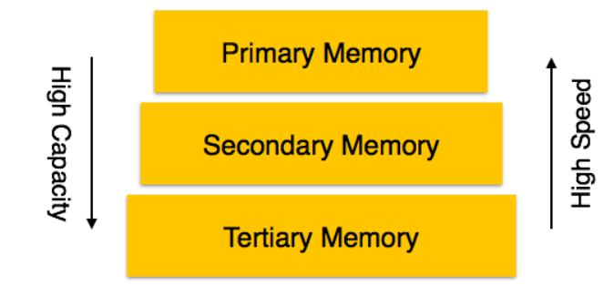
DBMS Storage
Databases are stored in file formats, which contain records. At physical level, the actual data is stored in electromagnetic format on some device. These storage devices can be broadly categorized into three types −

Slide 3
Primary Storage − The memory storage that is directly accessible to the CPU comes under this category. CPU's internal memory (registers), fast memory (cache), and main memory (RAM) are directly accessible to the CPU, as they are all placed on the motherboard or CPU chipset. This storage is typically very small, ultra-fast, and volatile. Primary storage requires continuous power supply in order to maintain its state. In case of a power failure, all its data is lost.
Secondary Storage − Secondary storage devices are used to store data for future use or as backup. Secondary storage includes memory devices that are not a part of the CPU chipset or motherboard, for example, magnetic disks, optical disks (DVD, CD, etc.), hard disks, flash drives, and magnetic tapes.
Tertiary Storage − Tertiary storage is used to store huge volumes of data. Since such storage devices are external to the computer system, they are the slowest in speed. These storage devices are mostly used to take the back up of an entire system. Optical disks and magnetic tapes are widely used as tertiary storage.

Slide 4
Memory Hierarchy
A computer system has a well-defined hierarchy of memory. A CPU has direct access to it main memory as well as its inbuilt registers. The access time of the main memory is obviously less than the CPU speed. To minimize this speed mismatch, cache memory is introduced. Cache memory provides the fastest access time and it contains data that is most frequently accessed by the CPU.
The memory with the fastest access is the costliest one. Larger storage devices offer slow speed and they are less expensive, however they can store huge volumes of data as compared to CPU registers or cache memory.

Slide 5
Magnetic Disks
Hard disk drives are the most common secondary storage devices in present computer systems. These are called magnetic disks because they use the concept of magnetization to store information. Hard disks consist of metal disks coated with magnetizable material. These disks are placed vertically on a spindle. A read/write head moves in between the disks and is used to magnetize or de-magnetize the spot under it. A magnetized spot can be recognized as 0 (zero) or 1 (one).

Slide 6
Redundant Array of Independent Disks
RAID or Redundant Array of Independent Disks, is a technology to connect multiple secondary storage devices and use them as a single storage media.
RAID consists of an array of disks in which multiple disks are connected together to achieve different goals. RAID levels define the use of disk arrays.

Slide 7
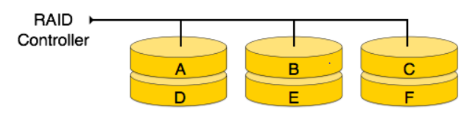
RAID 0
In this level, a striped array of disks is implemented. The data is broken down into blocks and the blocks are distributed among disks. Each disk receives a block of data to write/read in parallel. It enhances the speed and performance of the storage device. There is no parity and backup in Level 0.

Slide 8
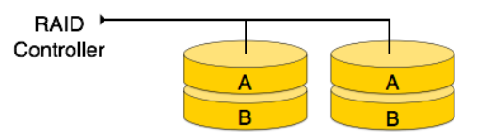
RAID 1
RAID 1 uses mirroring techniques. When data is sent to a RAID controller, it sends a copy of data to all the disks in the array. RAID level 1 is also called mirroring and provides 100% redundancy in case of a failure.

Slide 9
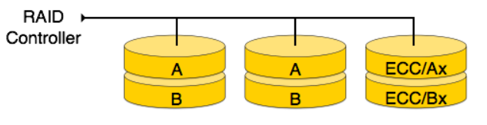
RAID 2
RAID 2 records Error Correction Code using Hamming distance for its data, striped on different disks. Like level 1, each data bit in a word is recorded on a separate disk and ECC codes of the data words are stored on a different set disks. Due to its complex structure and high cost, RAID 2 is not commercially available.

Slide 10
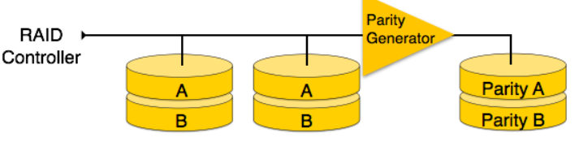
RAID 3
RAID 3 stripes the data onto multiple disks. The parity bit generated for data word is stored on a different disk. This technique makes it to overcome single disk failures.

Slide 11
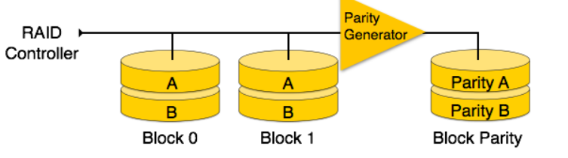
RAID 4
In this level, an entire block of data is written onto data disks and then the parity is generated and stored on a different disk. Note that level 3 uses byte-level striping, whereas level 4 uses block-level striping. Both level 3 and level 4 require at least three disks to implement RAID.

Slide 12
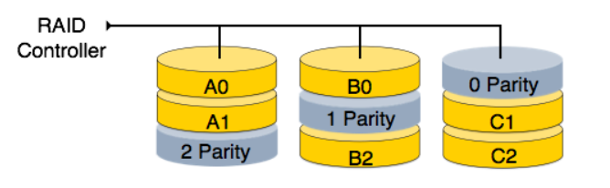
RAID 5
RAID 5 writes whole data blocks onto different disks, but the parity bits generated for data block stripe are distributed among all the data disks rather than storing them on a different dedicated disk.

Slide 13
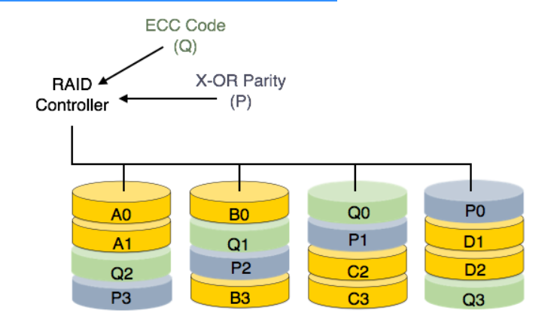
RAID 6
RAID 6 is an extension of level 5. In this level, two independent parities are generated and stored in distributed fashion among multiple disks. Two parities provide additional fault tolerance.

Slide 14
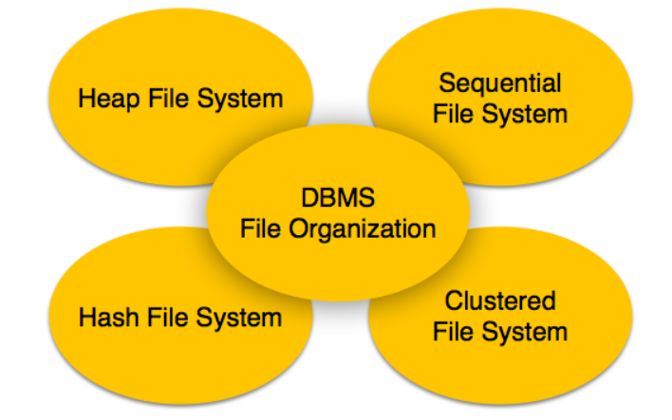
File Organization
File Organization defines how file records are mapped onto disk blocks. We have four types of File Organization to organize file records

Slide 15
Heap File
File records can be placed anywhere in that memory area. It is the responsibility of the software to manage the records. Heap File does not support any ordering, sequencing, or indexing on its own.

Slide 16
Sequential File
In sequential file organization, records are placed in the file in some sequential order based on the unique key field or search key. Practically, it is not possible to store all the records sequentially in physical form.

Slide 17
Hash File Organization
Hash File Organization uses Hash function computation on some fields of the records. The output of the hash function determines the location of disk block where the records are to be placed.

Slide 18
Clustered File Organization
Clustered file organization is not considered good for large databases. In this mechanism, related records from one or more relations are kept in the same disk block, that is, the ordering of records is not based on primary key or search key.

Slide 19
Assignment-2
DBMS Instance
DBMS Internal Memory Structure,
Background Processes
Data Types
Roles & Privileges

Slide 20
Query Processing

Slide 21
Translating SQL Queries into Relational Algebra
An SQL query is first translated into an equivalent extended relational algebra expression—represented as a query tree data structure—that is then optimized.
SQL queries are decomposed into query blocks, which form the basic units that can be translated into the algebraic operators

Slide 22
A query block contains a single SELECT-FROM-WHERE expression, as well as GROUP BY and HAVING clauses if these are part of the block. Hence, nested queries within a query are identified as separate query blocks

Slide 23
SELECT Lname, Fname
FROM EMPLOYEE
WHERE Salary > ( SELECT MAX (Salary)
FROM EMPLOYEE
WHERE Dno=5 );

Slide 24
Query Tree
SELECT schedule, room FROM Student NATURAL JOIN Enroll
NATURAL JOIN Class WHERE Major='Math'

Slide 25
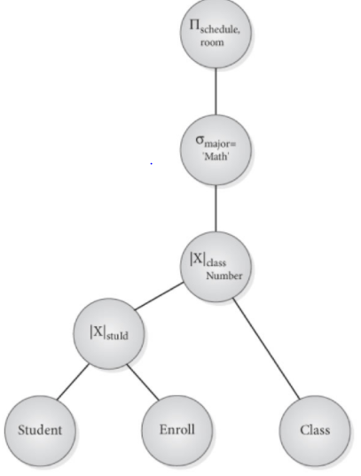
SELECT schedule, room FROM Student
NATURAL JOIN Enroll
NATURAL JOIN Class WHERE Major='Math'

Slide 26
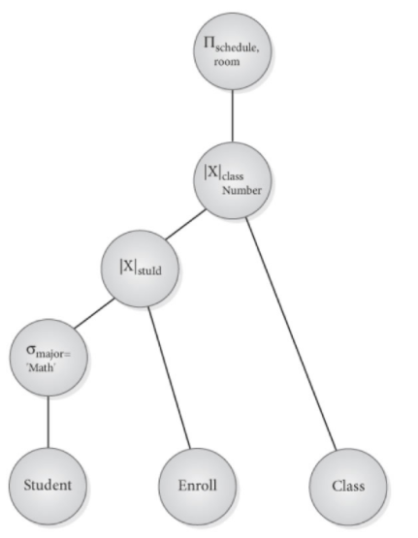

Slide 27
Algorithms for External Sorting
Sorting is one of the primary algorithms used in query processing.
For example, whenever an SQL query specifies an ORDER BY-clause, the query result must be sorted.
Sorting is also a key component in sort-merge algorithms used for JOIN and other operations (such as UNION and INTERSECTION), and in duplicate elimination algorithms for the PROJECT operation (when an SQL query specifies the DISTINCT option in the SELECT clause).

Slide 28
External sorting refers to sorting algorithms that are suitable for large files of records stored on disk that do not fit entirely in main memory, such as most data-base files.
The typical external sorting algorithm uses a sort-merge strategy, which starts by sorting small subfiles

Slide 29
In the sorting phase, runs (portions or pieces) of the file that can fit in the available buffer space are read into main memory, sorted using an internal sorting algorithm, and written back to disk as temporary sorted subfiles (or runs). The size of each run and the number of initial runs (n_{R}) are dictated by the number of file blocks (b) and the available buffer space (n_{B}).
For example, if the number of available main memory buffers n_{B} = 5 disk blocks and the size of the file b = 1024 disk blocks, then n_{R}= (b/n_{B}) or 205 initial runs each of size 5 blocks (except the last run which will have only 4 blocks). Hence, after the sorting phase, 205 sorted runs (or 205 sorted subfiles of the original file) are stored as temporary subfiles on disk.

Slide 30
In the merging phase, the sorted runs are merged during one or more merge passes. Each merge pass can have one or more merge steps. The degree of merging (d_{M}) is the number of sorted subfiles that can be merged in each merge step.
For example where n_{B} = 5, d_{M} = 4 (four-way merging), so the 205 initial sorted runs would be merged 4 at a time in each step into 52 larger sorted subfiles at the end of the first merge pass. These 52 sorted files are then merged 4 at a time into 13 sorted files, which are then merged into 4 sorted files, and then finally into 1 fully sorted file, which means that four passes are needed.

Slide 31
The performance of the sort-merge algorithm can be measured in the number of disk block reads and writes (between the disk and main memory) before the sorting of the whole file is completed. The following formula approximates this cost:
(2 * b) + (2 * b * (log_{dM} n_{R}))
Notes:
The first term (2 * b) represents the number of block accesses for the sorting phase, since each file block is accessed twice: once for reading into a main memory buffer and once for writing the sorted records back to disk into one of the sorted subfiles. The second term represents the number of block accesses for the merging phase. During each merge pass, a number of disk blocks approximately equal to the original file blocks b is read and written. Since the number of merge passes is (log_{dM} n_{R}), we get the total merge cost of (2 * b * (log_{dM} n_{R})).
The minimum number of main memory buffers needed is n_{B} = 3, which gives a d_{M} of 2 and an n_{R} of (b/3) . The minimum d_{M} of 2 gives the worst-case performance of the algorithm, which is:
(2 * b) + (2 * (b * (log₂ n_{R}))).

Slide 32
Algorithms for SELECT and JOIN Operations

Slide 33
Types of Select Operation
OP1: σ_{Ssn} _{= ‘123456789’} (EMPLOYEE)
OP2: σ_{Dnumber} _{> 5} (DEPARTMENT)
OP3: σ_{Dno} ₌ ₅ (EMPLOYEE)
OP4: ^{σ}Dno = 5 AND Salary > 30000 AND Sex = ‘F’ ^{(EMPLOYEE)}
OP5: ^{σ}Essn=‘123456789’ AND Pno =10^{(WORKS_ON)}

Slide 34
File Scans
Index Scans

Slide 35
Search Methods for Simple Selection
S1—Linear search (brute force algorithm). Retrieve every record in the file, and test whether its attribute values satisfy the selection condition. Since the records are grouped into disk blocks, each disk block is read into a main memory buffer, and then a search through the records within the disk block is conducted in main memory.
S2—Binary search. If the selection condition involves an equality comparison on a key attribute on which the file is ordered, binary search—which is more efficient than linear search—can be used. An example is OP1 if Ssn is the ordering attribute for the EMPLOYEE file

Slide 36
S3a—Using a primary index. If the selection condition involves an equality comparison on a key attribute with a primary index—for example, Ssn = ‘123456789’ in OP1—use the primary index to retrieve the record. Note that this condition retrieves a single record (at most).
S3b—Using a hash key. If the selection condition involves an equality com-parison on a key attribute with a hash key—for example, Ssn = ‘123456789’ in OP1—use the hash key to retrieve the record. Note that this condition retrieves a single record (at most).

Slide 37
S4—Using a primary index to retrieve multiple records. If the comparison condition is >, >=, <, or <= on a key field with a primary index—for exam-ple, Dnumber > 5 in OP2—use the index to find the record satisfying the cor-responding equality condition (Dnumber = 5), then retrieve all subsequent records in the (ordered) file. For the condition Dnumber < 5, retrieve all the preceding records.
S5—Using a clustering index to retrieve multiple records. If the selection condition involves an equality comparison on a nonkey attribute with a clustering index—for example, Dno = 5 in OP3—use the index to retrieve all the records satisfying the condition.

Slide 38
S6—Using a secondary index on an equality comparison. This search method can be used to retrieve a single record if the indexing field is a key (has unique values) or to retrieve multiple records if the indexing field is not a key. This can also be used for comparisons involving >, >=, <, or <=.

Slide 39
Search Methods for Complex Selection.
S7—Conjunctive selection using an individual index. If an attribute involved in any single simple condition in the conjunctive select condition has an access path that permits the use of one of the methods S2 to S6, use that condition to retrieve the records and then check whether each retrieved record satisfies the remaining simple conditions in the conjunctive select condition.

Slide 40
S8—Conjunctive selection using a composite index. If two or more attrib-utes are involved in equality conditions in the conjunctive select condition and a composite index exists on the combined fields— for example, if an index has been created on the composite key (Essn, Pno) of the WORKS_ON file for OP5—we can use the index directly.

Slide 41
S9—Conjunctive selection by intersection of record pointers.⁶ If second-ary indexes (or other access paths) are available on more than one of the fields involved in simple conditions in the conjunctive select condition, and if the indexes include record pointers (rather than block pointers), then each index can be used to retrieve the set of record pointers that satisfy the individual condition.

Slide 42
Algorithm for join operation
(OP6): EMPLOYEE DNO=DNUMBER DEPARTMENT
(OP7): DEPARTMENT MGRSSN=SSN EMPLOYEE

Slide 43
J1 Nested-loop join (brute force):
For each record t in R (outer loop), retrieve every record s from S (inner loop) and test whether the two records satisfy the join condition t[A] = s[B].
J2 Indexed based join (Using an access structure to retrieve the matching records):
If an index exists for one of the two join attributes — say, B of S — retrieve each record t in R, one at a time, and then use the access structure to retrieve directly all matching records s from S that satisfy s[B] = t[A].

Slide 44
J3 Sort-merge join:
If the records of R and S are physically sorted (ordered) by value of the join attributes A and B, respectively, we can implement the join in the most efficient way possible.
J4 Hash-join:
The records of files R and S are both hashed to the same hash file, using the same hashing function on the join attributes A of R and B of S as hash keys.

Slide 45
Algorithms for PROJECT and SET Operations
Set operations—UNION, INTERSECTION, SET DIFFERENCE, and CARTESIAN PRODUCT—are sometimes expensive to implement. In particular, the CARTESIAN PRODUCT operation R × S is quite expensive because its result includes a record for each combination of records from R and S.
Also, each record in the result includes all attributes of R and S. If R has n records and j attributes, and S has m records and k attributes, the result relation for R × S will have n * m records and each record will have j + k attributes.

Slide 46
The other three set operations—UNION, INTERSECTION, and SET DIFFERENCE—apply only to type-compatible (or union-compatible) relations, which have the same number of attributes and the same attribute domains. The customary way to implement these operations is to use variations of the sort-merge technique
Hashing can also be used to implement UNION, INTERSECTION, and SET DIFFERENCE. One table is first scanned and the records in the other table are then scanned one at a time and used to probe the appropriate location.

Slide 47
Implementing Aggregate Operations
The aggregate operators (MIN, MAX, COUNT, AVERAGE, SUM), when applied to an entire table, can be computed by a table scan or by using an appropriate index, if available. For example, consider the following SQL query:
SELECT MAX(Salary) FROM EMPLOYEE;

Slide 48
If index on Salary exists for the EMPLOYEE relation, then the optimizer can decide on using the Salary index to search for the largest Salary value in the index.
The index could also be used for the AVERAGE and SUM aggregate functions, but only if it is a dense index—that is, if there is an index entry for every record in the main file.
When a GROUP BY clause is used in a query, the aggregate operator must be applied separately to each group of tuples as partitioned by the grouping attribute.

